Slide 1

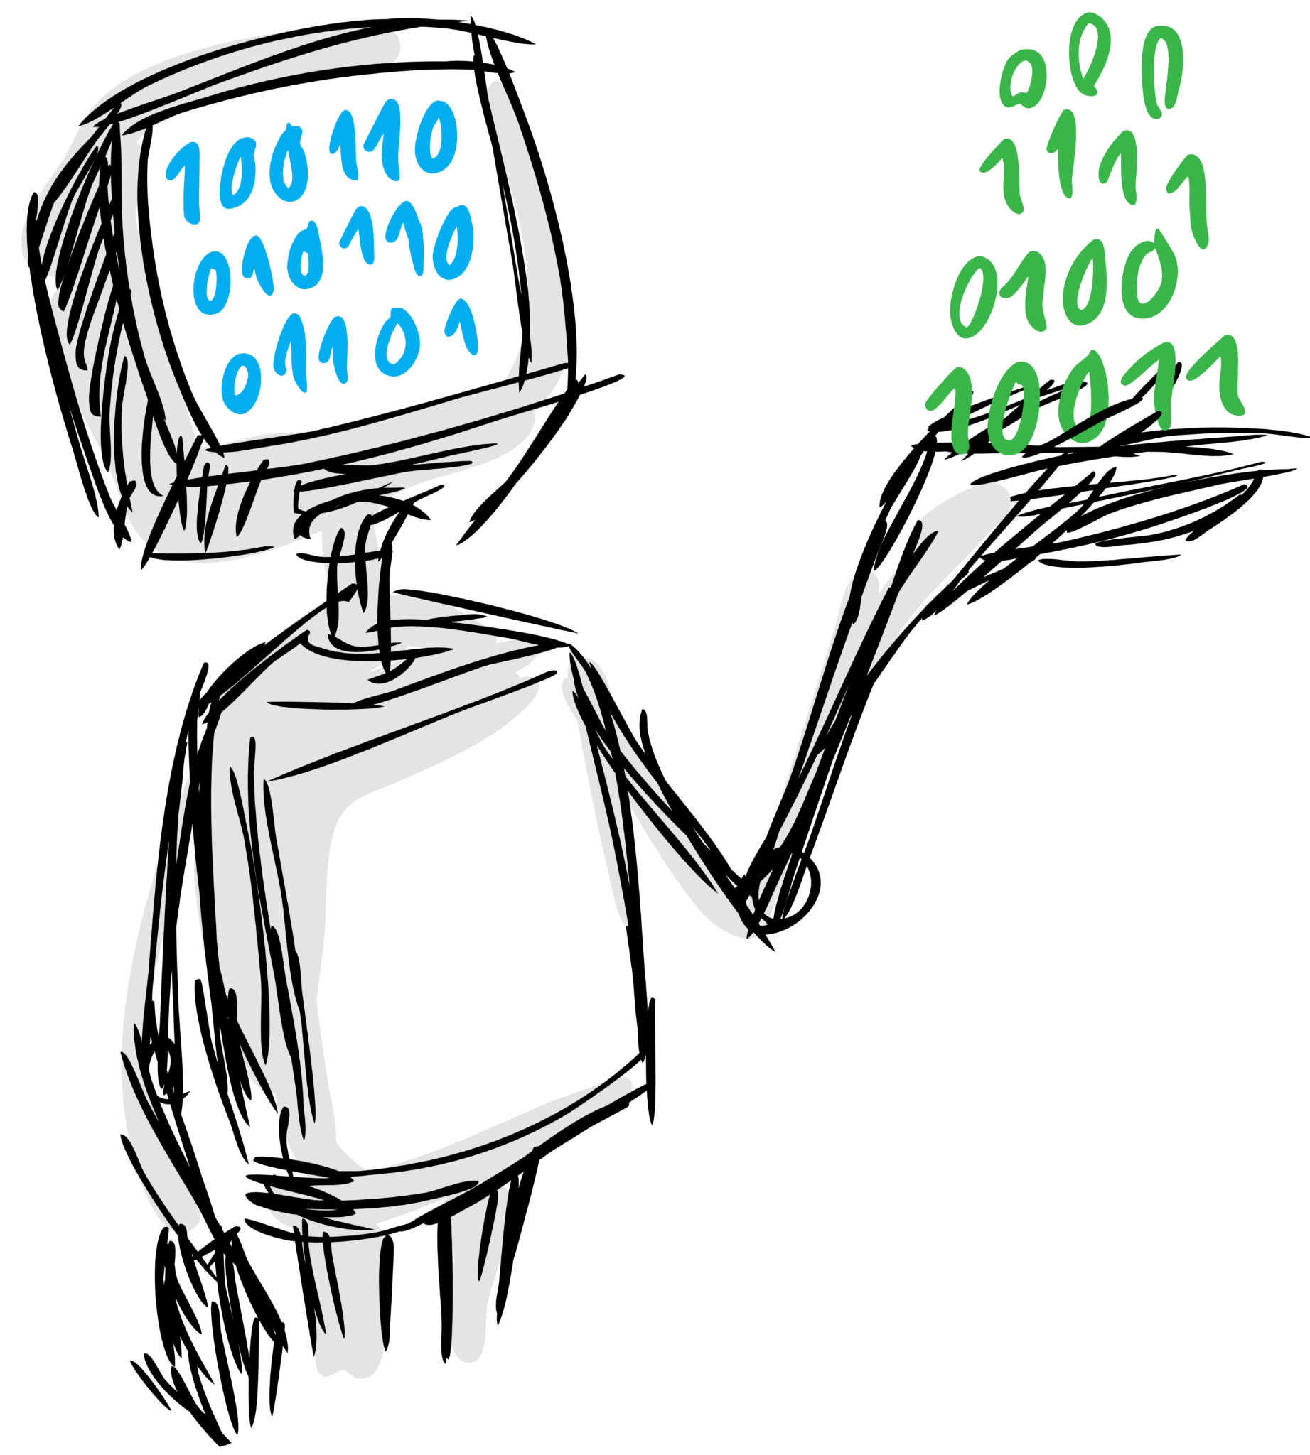
Interpretability in Data-Centric ML
Alexandra (Ola) Zytek
Introduction to Data-Centric AI
IAP 2023
DATA TO AI

Slide 2
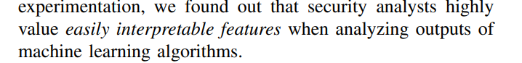

Slide 3
Roadmap
Introduction to interpretable ML
Why do we care about interpretable features?
What are interpretable features really?
How do we get interpretable features?

Slide 4
Introduction to interpretable ML
Why do we care about interpretable features?
What are interpretable features really?
How do we get interpretable features?

Slide 5
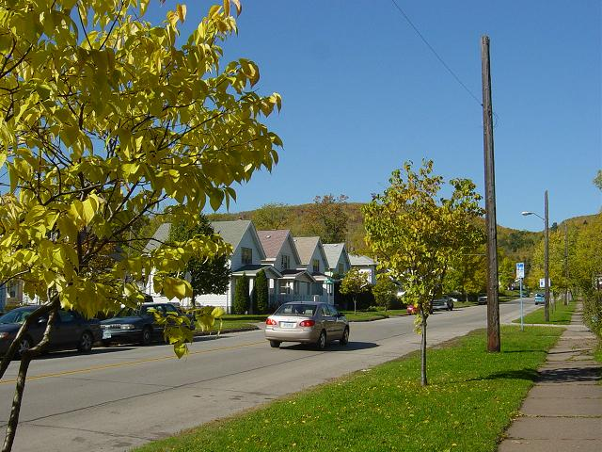

Location:
Denfield
?
Population:
120
Median House Price:
$198,000
Median Income:
$32,000

Slide 6
Why do we need interpretable ML?
Debugging and validation
Reviewing decisions
Improving usability

Slide 7
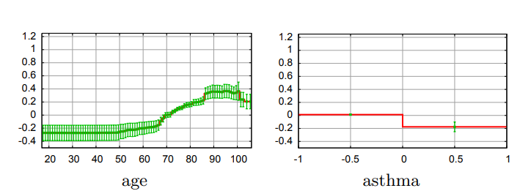
Debugging and Validation
Risk of pneumonia death
Caruana, R., Lou, Y., Gehrke, J., Koch, P., Sturm, M., & Elhadad, N. (2015). Intelligible Models for HealthCare: Predicting Pneumonia Risk and Hospital 30-day Readmission. Proceedings of the 21th ACM SIGKDD International Conference on Knowledge Discovery and Data Mining, 1721–1730

Slide 8
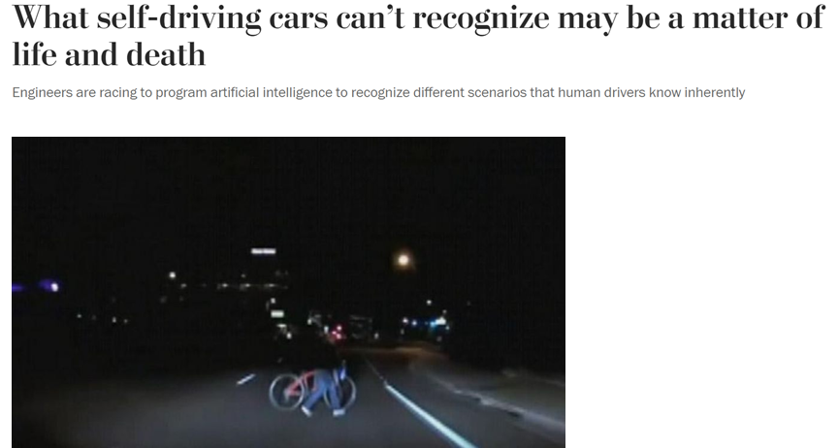
Reviewing Decisions
Siddiqui, F. (2019, November 27). What self-driving cars can’t recognize may be a matter of life and death. Washington Post.

Slide 9

Improving Usability
Past experiences
17!
Outside information
Personal values
Data

Slide 10
We need interpretable ML…
When the problem formulation is incomplete
When there is associated risk
When humans are involved in decision-making

Slide 11
Introduction to interpretable ML
Why do we care about interpretable features?
What are interpretable features really?
How do we get interpretable features?

Slide 12
Location:
South San Francisco
Population:
1,703
?
Median House Price:
$321,000
Median Income:
$34,231
…

Slide 13
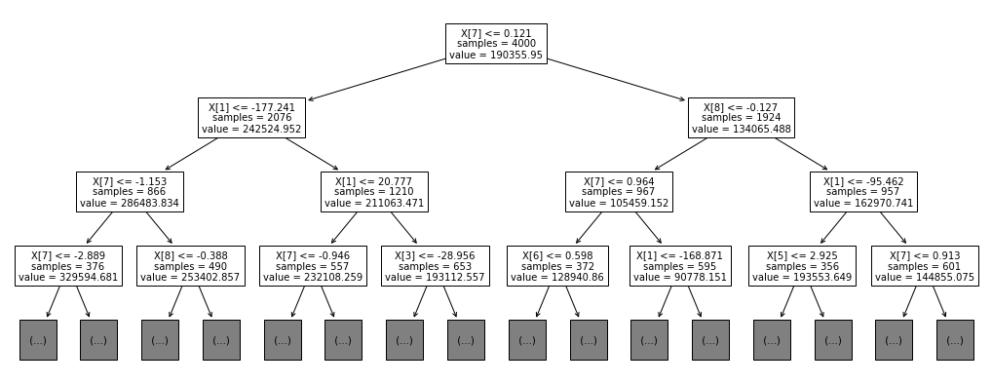
Notes:
Decision tree example

Slide 14
Notes:
Decision tree example

Slide 15
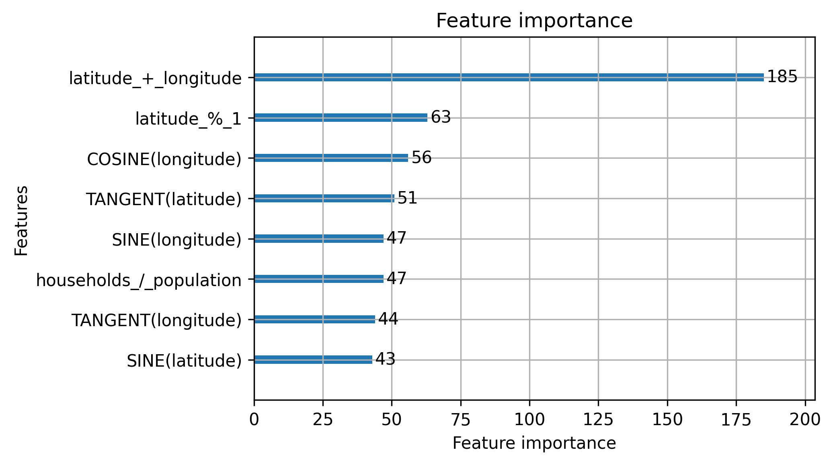

Slide 16
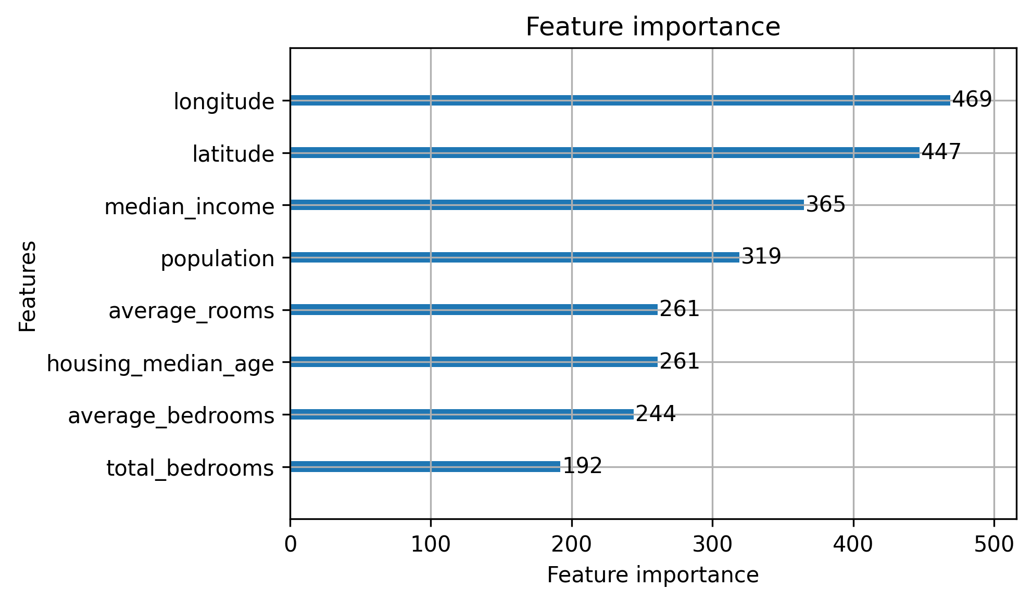

Slide 17

Case Study: Child Welfare
Screen In
Screen Out
Zytek, A., Liu, D., Vaithianathan, R., & Veeramachaneni, K. (2021). Sibyl: Understanding and Addressing the Usability Challenges of Machine Learning In High-Stakes Decision Making. IEEE Transactions on Visualization and Computer Graphics, 1–1. https://doi.org/10.1109/TVCG.2021.3114864

Slide 18

Case Study: Child Welfare
Screen In
Screen Out
1- 20

Slide 19
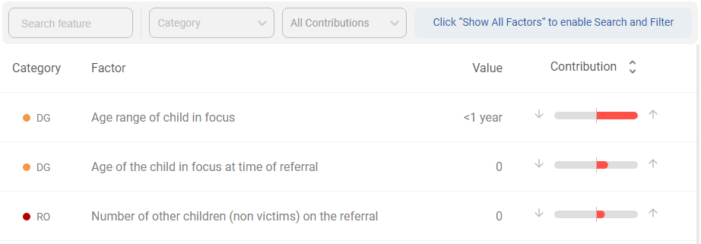

Slide 20
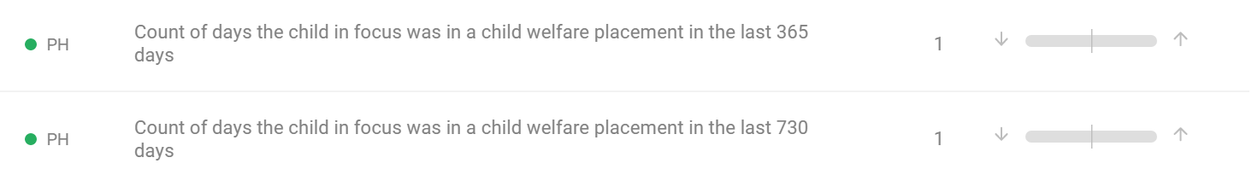
Problem: Confusing Features

Slide 21


Problem: Confusing Language
“The ‘true’ and ‘false’ is hard to interpret... Would rather have a positive statement (e.g., no perpetrator named)” –Child Welfare Screener

Slide 22
Problem: Irrelevant Features
“2 parents have missing date-of-birth is shown as a significant blue bar which I can’t imagine is protective.” – Child Welfare Screener

Slide 23
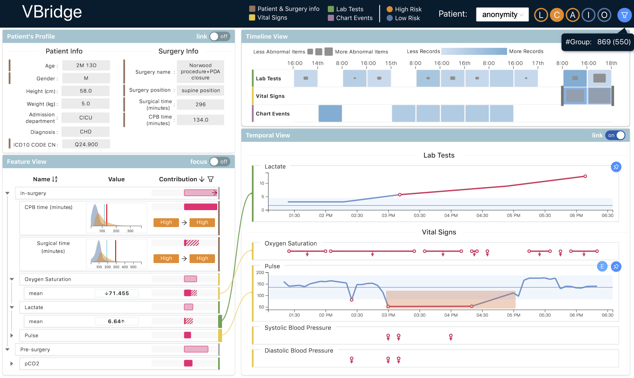
Case Study: Electronic Health Records
Cheng, F., Liu, D., Du, F., Lin, Y., Zytek, A., Li, H., Qu, H., & Veeramachaneni, K. (2021). VBridge: Connecting the Dots Between Features and Data to Explain Healthcare Models. IEEE Transactions on Visualization and Computer Graphics, 1–1.

Slide 24
Problem: Unnatural Data Format

Slide 26
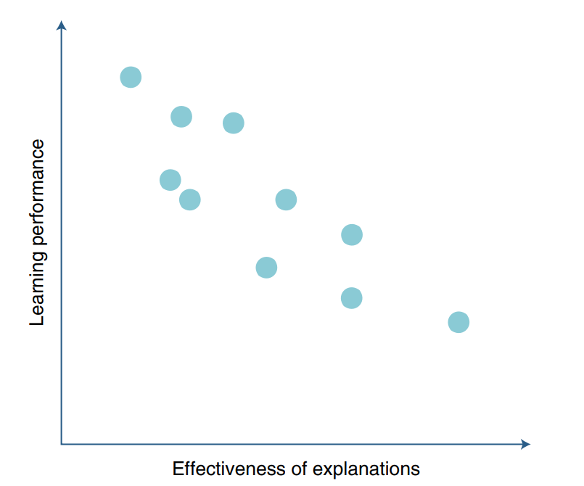
Performance and Interpretability
Interpretability leads to…
More efficient training
Better generalization
Fewer adversarial examples
The interpretability-performance tradeoff is (mostly) a myth
Rudin, C. Stop explaining black box machine learning models for high stakes decisions and use interpretable models instead. Nat Mach Intell 1, 206–215 (2019).
Ilyas, A., Santurkar, S., Tsipras, D., Engstrom, L., Tran, B., & Madry, A. (2019). Adversarial Examples Are Not Bugs, They Are Features (arXiv:1905.02175).

Slide 27
Performance and Interpretability
Interpretability leads to…
More efficient training
Better generalization
Fewer adversarial examples
The interpretability-performance tradeoff is (mostly) a myth
Rudin, C. Stop explaining black box machine learning models for high stakes decisions and use interpretable models instead. Nat Mach Intell 1, 206–215 (2019).
Ilyas, A., Santurkar, S., Tsipras, D., Engstrom, L., Tran, B., & Madry, A. (2019). Adversarial Examples Are Not Bugs, They Are Features (arXiv:1905.02175).

Slide 28
Introduction to interpretable ML
Why do we care about interpretable features?
What are interpretable features really?
How do we get interpretable features?

Slide 29
What are interpretable features really?
The features that are most useful and meaningful to the user

Slide 30
Example: Housing Price Prediction
Area Quality (numeric) | Average House Size (numeric) | Most Common House Color (categorical) | Normalized Median Income (numeric) | x12 (numeric)
Zytek, A., Arnaldo, I., & Liu, D. (2022). The Need for Interpretable Features: Motivation and Taxonomy. SIGKDD Explorations, 24(1).

Slide 31
 | Area Quality (numeric) | Average House Size (numeric) | Common House Color (categorical) | Normalized Median Income (numeric) | x12 (numeric)
Readable | ✓ | ✓ | ✓ | ✓

Slide 32
 | Area Quality (numeric) | Average House Size (numeric) | Common House Color (categorical) | Normalized Median Income (numeric) | x12 (numeric)
Readable | ✓ | ✓ | ✓ | ✓
Understandable | ✓ | ✓ | ✓

Slide 33
 | Area Quality (numeric) | Average House Size (numeric) | Common House Color (categorical) | Normalized Median Income (numeric) | x12 (numeric)
Readable | ✓ | ✓ | ✓ | ✓
Understandable | ✓ | ✓ | ✓
Relevant | ✓ | ✓

Slide 34
 | Area Quality (numeric) | Average House Size (numeric) | Common House Color (categorical) | Normalized Median Income (numeric) | x12 (numeric)
Readable | ✓ | ✓ | ✓ | ✓
Understandable | ✓ | ✓ | ✓
Relevant | ✓ | ✓
Abstract Concept | ✓

Slide 35
Introduction to interpretable ML
Why do we care about interpretable features?
What are interpretable features really?
How do we get interpretable features?

Slide 36
“[Feature engineering] is the first step to making an interpretable model, even if we don’t have a model yet” – Data Scientist
Hong, S. R., Hullman, J., & Bertini, E. (2020). Human Factors in Model Interpretability: Industry Practices, Challenges, and Needs. Proceedings of the ACM on Human-Computer Interaction, 4(CSCW1), 1–26.

Slide 37
Methods for Interpretable Features
Including the user
Using interpretable feature transformations
Using interpretable feature generation

Slide 38
Iterative Design Process (for Features)
Initial Planning
Requirements
Analysis and Design
Implement
Testing
Planning
Evaluation
Deployment
Notes:
Including domain experts

Slide 39
Collaborative Feature Engineering
Improve the process of crafting human-generated features
Crowd source feature generation
Allow domain experts to directly participate
Notes:
https://dai.lids.mit.edu/wp-content/uploads/2018/02/featurehub-smith-1.pdf
https://hci.stanford.edu/publications/2015/Flock/flock_paper.pdf

Slide 40
Flock: Choosing features through comparisons
Machine-generate features for a prediction task
Crowd-generate features
Cluster crowd-generated features
Iterate on inaccurate model nodes
Cheng, J., & Bernstein, M. S. (2015). Flock: Hybrid Crowd-Machine Learning Classifiers. Proceedings of the 18th ACM Conference on Computer Supported Cooperative Work & Social Computing, 600–611.

Slide 41
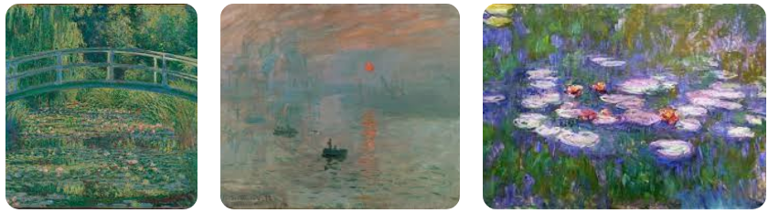
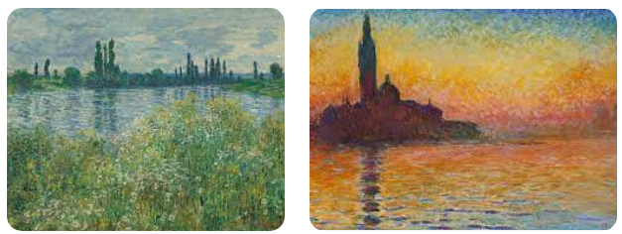
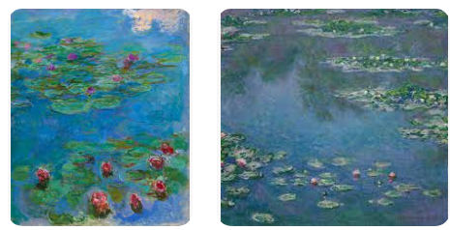

Slide 42
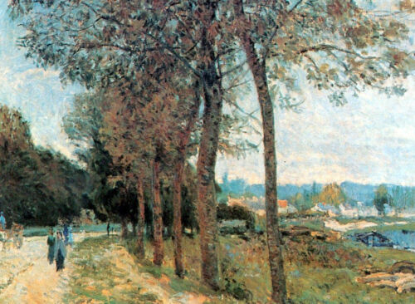
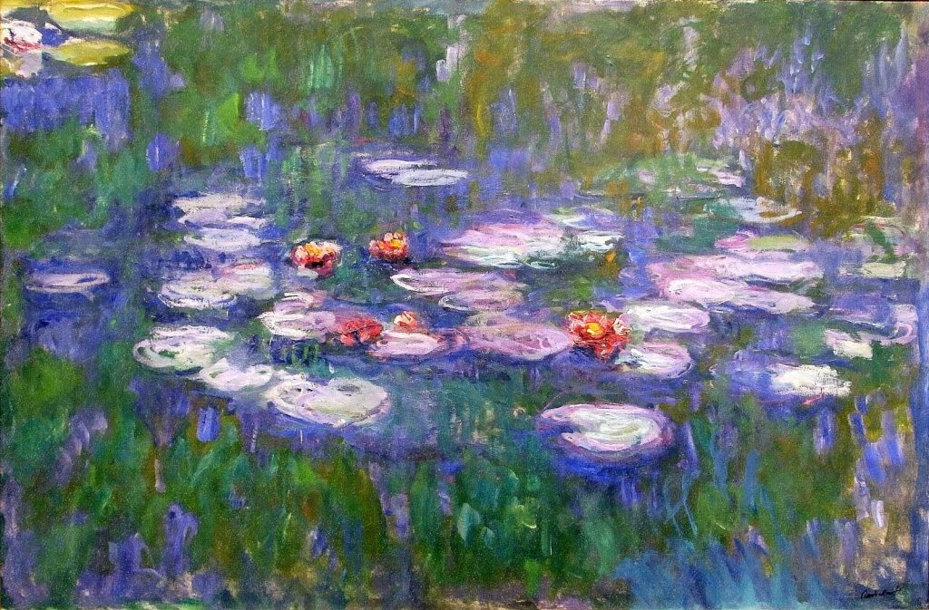
The first painting is probably a Monet because it has lilies in it, and looks like Monet’s style. The second probably isn’t Monet because Monet doesn’t normally put people in his paintings.

Slide 43
Split by conjunctions…
The first painting is probably a Monet because it has lilies in it, and looks like Monet’s style. The second probably isn’t Monet because Monet doesn’t normally put people in his paintings.
Cluster using any clustering algorithm…
The first painting is probably a Monet because it has lilies in it
It has flowers
The painting including lilies
There are flowers and lilies in the painting
Crowd-source an aggregated feature label
Does the painting have flowers/lilies?

Slide 44
Results
Flock outperforms:
Original features/data used directly
Machine-engineered features only
Crowd classifications
And generates interpretable features, ie.
Contains flowers
Is abstract
Does not contain people

Slide 45
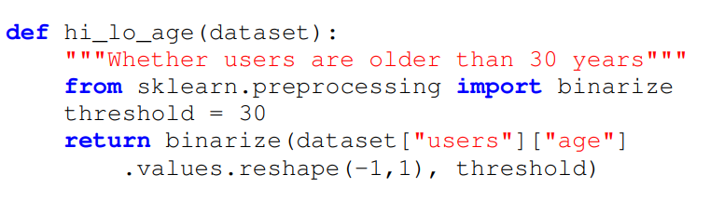
Ballet: Feature Engineering with Feedback
Abstract away model building/training/evaluating
Write features with only simple Python
Smith, M. J., Cito, J., Lu, K., & Veeramachaneni, K. (2021). Enabling collaborative data science development with the Ballet framework. Proceedings of the ACM on Human-Computer Interaction, 5(CSCW2), 1-39.

Slide 46
Methods for Interpretable Features
Including the user
Using interpretable feature transformations
Using interpretable feature generation

Slide 47

Pyreal: System for Interpretable Transforms
Data
Original Feature Space
Explanation-Algorithm Feature Space
Interpretable Feature Space
Data
Explanation
Data
Prediction
Model-Ready Feature Space
https://dtail.gitbook.io/pyreal/

Slide 48
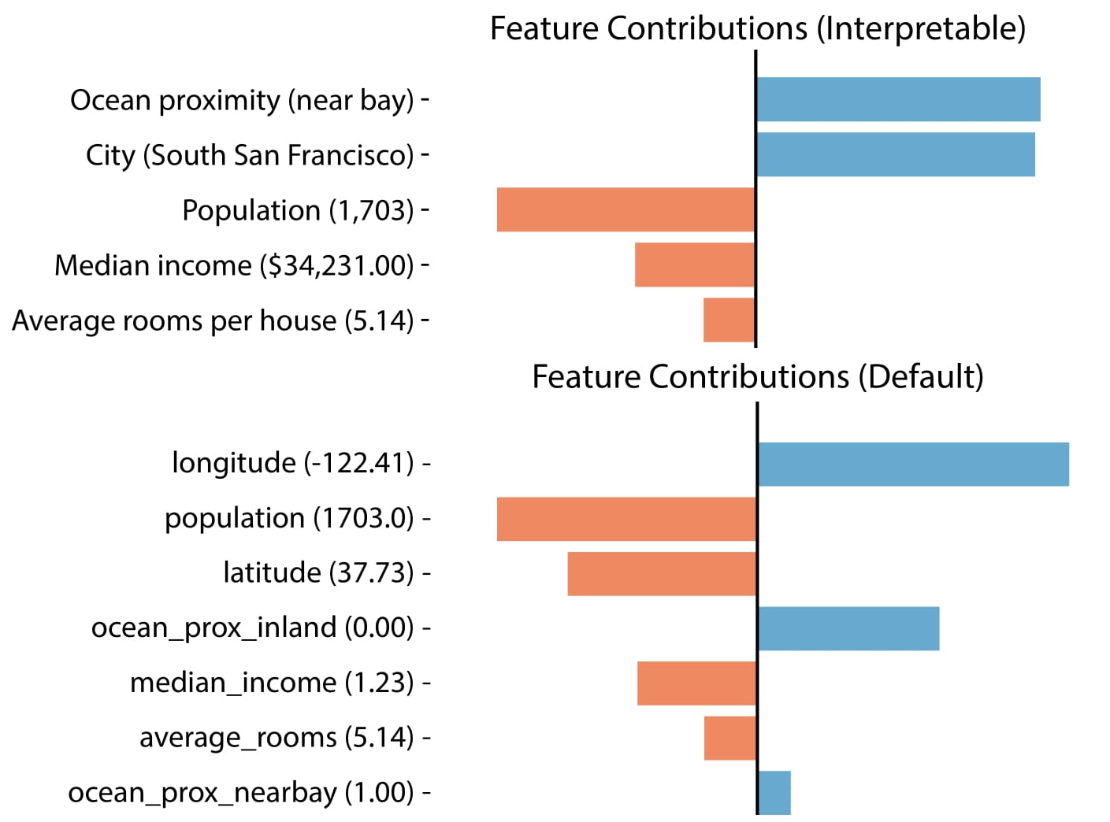
Notes:
Examples of explanations with/without interpretable data

Slide 49
Notes:
Examples of explanations with/without interpretable data

Slide 50
Notes:
Examples of explanations with/without interpretable data

Slide 51
Methods for Interpretable Features
Including the user
Using interpretable feature transformations
Using interpretable feature generation

Slide 52
Mind the Gap Model (MGM)
Assign features to groups with AND or OR
lays eggs
backbone
AND
tail
toothed
OR
predator
Kim, B., Shah, J. A., & Doshi-Velez, F. (2015). Mind the Gap: A Generative Approach to Interpretable Feature Selection and Extraction. Advances in Neural Information Processing Systems, 28.

Slide 53
Mind the Gap Model (MGM)
2. Identify groups maximize separation and iterate

Slide 54
Mind the Gap Model (MGM)
backbone
OR
Tail
OR
Toothed
lays eggs
predator
0
1
.5
Mammal

Slide 55
Conclusion
ML models are only as interpretable as their features
Interpretable features are those that are meaningful to the user
Interpretable features are generated by including users, focusing on interpretable transforms, and using feature generation algorithms that consider interpretability

Slide 56
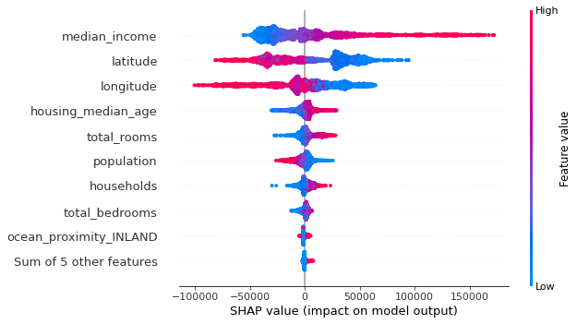
Lab
Use explanation algorithms to identify flawed data

